Slide 1
Understanding status of our technical group

Slide 2
To Be Defined :
Capsule
Test Automation
Current Status : Existing , Newly Added , Being Added
3
IoT
Device
1
Mutation
Analysis
ST Cloud
Bixby Cloud
KAIST
<<includes>>
신기혁
<<includes>>
<<includes>>
<<includes>>
Measure
Quality
TC
Identify
SRI-B (2)
One Log
송창선
김진한
<<includes>>
<<includes>>
2
TCM
이상훈
<<extends>>
이영철
LMF
AI Enabled
Test
<<indirectly
includes>>
<<extends>>
<<extends>>
유수희
박치성
전현석
TC
Checker
허성찬
Commit Diff
Anomaly
Detection
SRI-B (2)
<<includes>>
AST Level
Analysis
Procedural
Analysis
Stochastic
Analysis
Log
ISP-RAS
AI
선광원
TC
검증
Tizen SES
E2E Speech
Recognition(II)
품질 체계
구축
Intelligent
Conversational Assistant
SRBD

Slide 3
Why are new task items have been being added continuously?
Why have been always those new task items given as the 1st priority?
Think about “Whys”

Slide 4
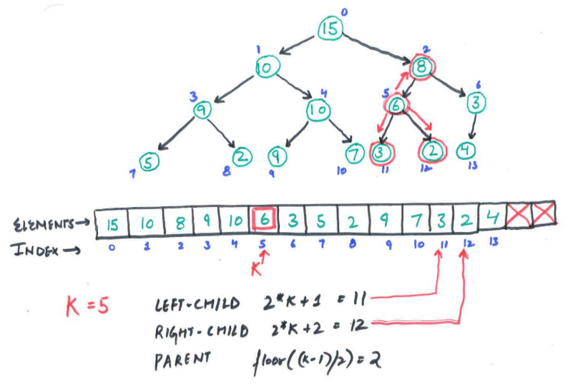
Imagine “Priority Queue”
when a node is added or removed,
up-heap() , down-heap()
only need to keep heap properties!

Slide 5
Please remind history and think about “what to do”
“Demands
Agility”
Technical Group
Merging
New Task
Assignment
Task
Prioritization
“Tasks Dependent
On Other Groups”
“Bixby Solution”
“TC Less Testing”
New Task
Plan
Keep Task
Plan
Exit
Plan
“Too Small
Task Granularity”
“Keep Current
Placement”
MBO
Release
Planned
To Be Integrated
Future
Preparation
1st
2nd
4th
3rd
Not Yet Clear
Constraints
Unable To
Change Req
Contraction
/w Outsourcing
Limited
Resources

Slide 6
Let’s decide those priorities democratically by voting later this week !
This is the reason why we’re here now

